Slide 1
Inferring Causality with Observational Data: Picking Control Variables & Regression Discontinuity
Matt Goldman

Slide 2
How To Pick Control Variables

Slide 3
Goal: Pick Control Variables so that you get closer to a “natural experiment”

Slide 4
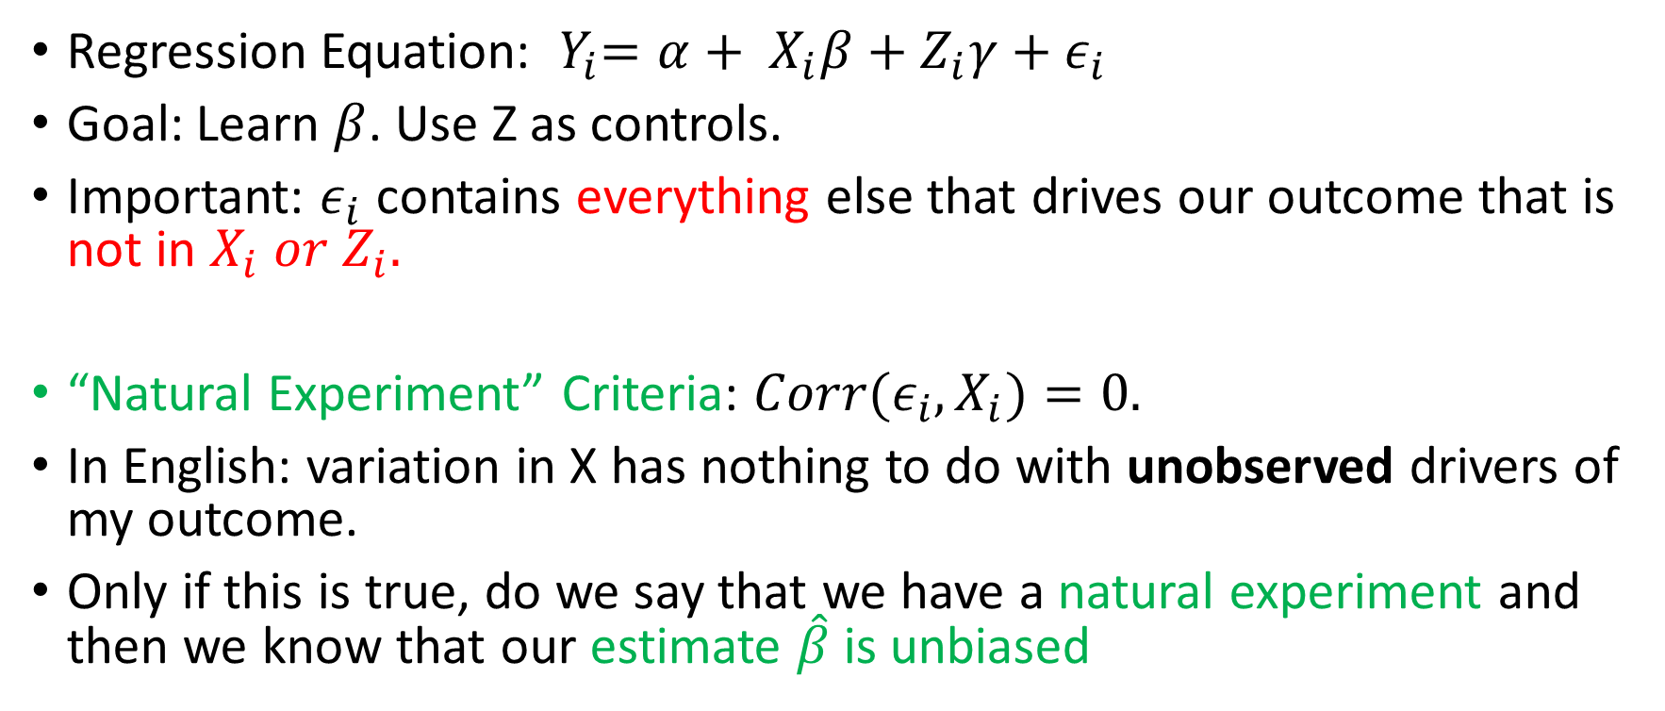
The “Natural Experiment” Criteria
Regression Equation: ${ Y}_{i}=α+ X_{i}β+Z_{i}γ+ε_{i}$
Goal: Learn $β$. Use Z as controls.
Important: $ε_{i}$ contains everything else that drives our outcome that is not in $X_{i} or Z_{i}.$
“Natural Experiment” Criteria: ${Corr(ε}_{i},X_{i})=0.$
In English: variation in X has nothing to do with unobserved drivers of my outcome.
Only if this is true, do we say that we have a natural experiment and then we know that our estimate $\hat{β}$ is unbiased

Slide 5
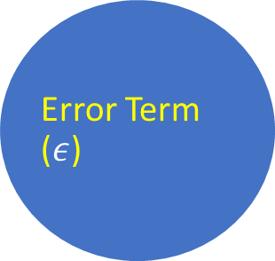
Graphical Depiction of “Natural Experiment” Criteria
Treatment (X)
Outcome (Y)
Treatment may cause the outcome
Error Term ($ε$)
Notes:
example insight from book
airlines leading example

Slide 6
Graphical Depiction of “Natural Experiment” Criteria
Treatment (X)
Outcome (Y)
Error Term ($ε$)
Other unobserved things (error term) can cause Y
Notes:
example insight from book
airlines leading example

Slide 7
Graphical Depiction of “Natural Experiment” Criteria
Treatment (X)
Outcome (Y)
Error Term ($ε$)
Treatment selection can not be caused by the error term
Notes:
example insight from book
airlines leading example

Slide 8

Graphical Depiction of “Natural Experiment” Criteria
Treatment (X)
Outcome (Y)
Error Term ($ε$)
The error term can not be caused by treatment selection
Notes:
example insight from book
airlines leading example

Slide 9
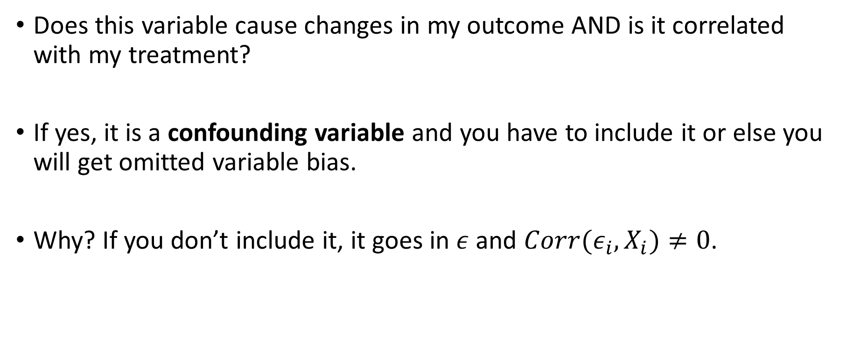
Picking Controls: Confounding Variable
Does this variable cause changes in my outcome AND is it correlated with my treatment?
If yes, it is a confounding variable and you have to include it or else you will get omitted variable bias.
Why? If you don’t include it, it goes in $ε$ and ${Corr(ε}_{i},X_{i})≠0$.

Slide 10
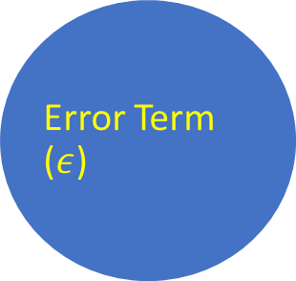
Graphical Depiction of Confounding Variables
Outcome (Y)
This is okay because we observe and control for the confounding variable by putting it in the regression!
Treatment (X)
Confounding Variable (Z)
Error Term ($ε$)
Notes:
example insight from book
airlines leading example

Slide 11
Graphical Depiction of Confounding Variables
Outcome (Y)
This is okay because we observe and control for the confounding variable by putting it in the regression!
But what happens if we remove the confounding variable from our regression?
Treatment (X)
Confounding Variable (Z)
Error Term ($ε$)
Notes:
example insight from book
airlines leading example

Slide 12
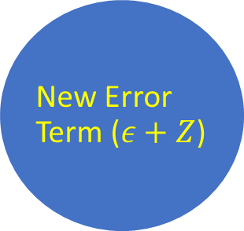
Graphical Depiction of Confounding Variables
This is okay because we observe and control for the confounding variable by putting it in the regression!
But what happens if we remove the confounding variable from our regression?
It goes into the error term. Not ok!
Treatment (X)
Outcome (Y)
New Error Term ($ε+Z$)
Notes:
example insight from book
airlines leading example

Slide 13
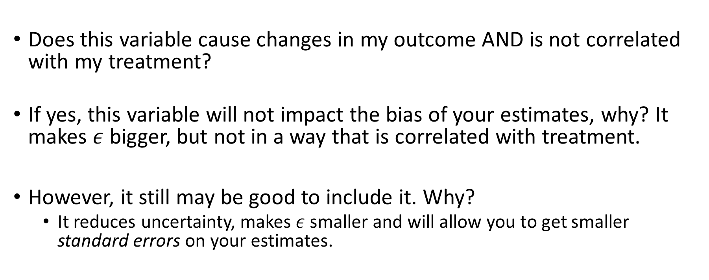
Picking Controls: Variance-Reducing Variables
Does this variable cause changes in my outcome AND is not correlated with my treatment?
If yes, this variable will not impact the bias of your estimates, why? It makes $ε$ bigger, but not in a way that is correlated with treatment.
However, it still may be good to include it. Why?
It reduces uncertainty, makes $ε$ smaller and will allow you to get smaller standard errors on your estimates.

Slide 14
Picking Controls: Unrelated Variables
Does this variable not cause changes in my outcome?
If yes, this variable will not be helpful to your regression. It will just induce a little bit of overfitting and you should drop it.
If a control variable has a statistically insignificant t-stat (|t|<1.96), you can conclude that it is unrelated and should usually drop it from your regression.

Slide 15
Picking Controls: “Bad Controls”
Is this variable caused by my treatment of interest?
If yes: I absolutely can NOT include it in my regression. Ignore all other considerations and drop it from the regression.
Why? It might be obscuring the treatment effect (if that effect is channeled through the “bad control”)
Good rule of thumb: any variable which is not determined until after the intervention/treatment takes place is probably a “bad control”.

Slide 16
Summary
It is a catastrophe if you don’t include: Confounding Variables.
It is good to include: Variance-Reducing Variables
It is a waste to include: Unrelated variables.
It is a catastrophe if you do include: Bad Controls

Slide 17
Ex.: Returns to College Education
You must include Confounding Variables:
Ex: Parent’s Education, Parent’s Income, Geographic Controls, # Siblings, High-school GPA, SAT score…
It is good to include: Variance-Reducing Variables
Ex: Economic conditions the year you graduate college
It is a waste to include: Unrelated variables.
Student’s favorite NBA player, student’s astrological sign, whether or not student owns exactly 8 pairs of pants
It is a catastrophe if you include: Bad Controls.
Ex: Number of LinkedIn Connections after college, where student lives after college, other wage data from after college

Slide 18
Research Design: Regression Discontinuity

Slide 19
Discontinuity
An arbitrary change in treatment assignment that happens at a specific threshold.
We’re interested in the ones that make very similar people get very dissimilar treatment.

Slide 20
Discontinuity Examples: Incumbency Advantage
U.S. House Elections
If you’re first past the pole in the previous election, even by just one vote, you get elected
What can we learn from this?
Incumbency advantage for reelection.
(David Lee, Journal of Econometrics 2007)

Slide 21
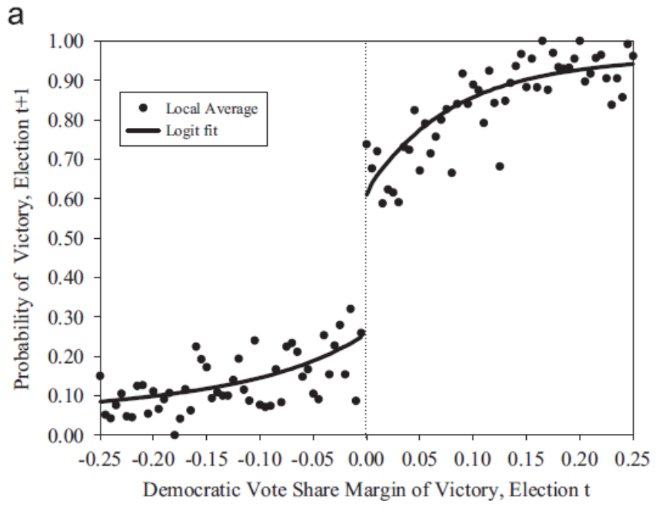
Discontinuity Examples: Incumbency Advantage
Question: All else equal, does winning one political election help you win the next election? (Incumbency effect)
Bad Answer (OLS): Compare the average performance of winners and losers.
Problem: Winning the first election is not random. Is likely to be correlated with characteristics of local electorate. In this case, estimate of effect is biased up.

Slide 22
Regression Discontinuity (RD)
Question: All else equal, does winning one political election help you win the next election? (Incumbency effect)
Best Solution: Compare elections where the Democrats get ~49.9% of vote to elections where they get ~50.1%.
NOTE: This approach is only possible because treatment (winning the first election) is assigned based on a threshold.
Polynomial trends on each side of discontinuity mitigate bias.

Slide 23
Discontinuity Examples: PSAT
PSAT/NMSQT
Basically the top 16,000 test-takers get a scholarship.
A small difference in test score can means a discontinuous jump in scholarship amount.
What can we learn from this?
Wage returns to scholarships/education
Notes:
Supposed to be by Thistlewaite, but I can’t find the reference

Slide 24
Discontinuity Examples: Class Size
School Class Size
Maimonides’ Rule--No more than 40 kids in a class in Israel.
40 kids in school means 40 kids per class. 41 kids means two classes with 20 and 21.
What can we learn from this?
Impact of class size on test scores/performance
(Angrist & Lavy, QJE 1999)

Slide 25
Discontinuity Examples: Impact of Unionization
Union Elections
If employers want to unionize, NLRB holds election. 50% means the employer doesn’t have to recognize the union, and 50% + 1 means the employer is required to “bargain in good faith” with the union.
What can we learn from this?
Impact of unionization on wages/employment/firm closure…
(DiNardo & Lee, QJE 2004)

Slide 26
A Bandwidth of Randomness
Election outcomes aren’t random so incumbency is never randomly assigned
But is a district that voted 50.1% for a democrat that different from one that voted 49.9% for a democrat?
Probably not. Right around the cutoff, there’s a good chance things are random.
However, picking the right window size around the cutoff is difficult. You should try to pick it so that you a “convincing picture”.

Slide 27
Implementing a Regression Discontinuity: Definitions
Y: outcome
r: running variable
c: cutoff
T: treatment

Slide 28
Implementing a Regression Discontinuity: Definitions
Y: outcome
r: running variable
c: cutoff
T: treatment

Slide 29
Implementing a Regression Discontinuity: Definitions
Y: outcome
r: running variable
c: cutoff
T: treatment

Slide 30
Implementing a Regression Discontinuity: Definitions
Y: outcome
r: running variable
c: cutoff
T: treatment

Slide 31
Implementing a Regression Discontinuity: Definitions
Y: outcome
r: running variable
c: cutoff
T: treatment
T=1 if (r>c)

Slide 32
Implementing a Regression Discontinuity: Method
Select a subset of data around the discontinuity (c). I.E. |r-c|<h for some “reasonable value of h”.
Regressors:
1: Constant
(r>c): Treatment
1{r>c}*(r-c): linear trend above treatment
1{r<c}*(r-c): linear trend below treatment
Can also include (if it improves fit):
1{r>c}*(r-c)^2, 1{r>c}*(r-c)^3: cubic trend above treatment
1{r<c}*(r-c)^2, 1{r<c}*(r-c)^3 : cubic trend below treatment

Slide 33
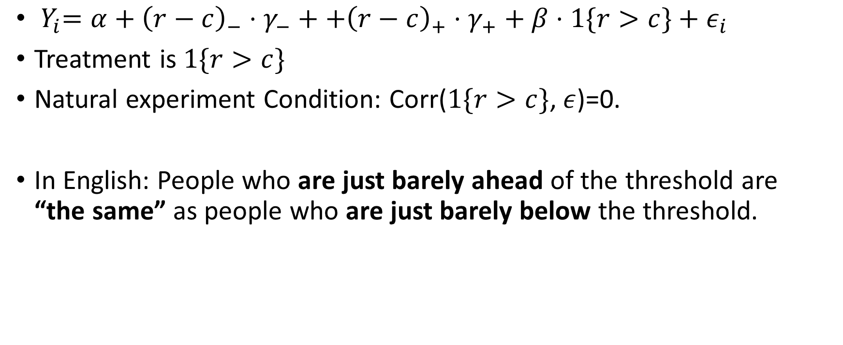
Implementing a Regression Discontinuity: Key Assumption
${ Y}_{i}=α+{\left(r−c\right)}_{−}⋅γ_{−}++{\left(r−c\right)}_{+}⋅γ_{+}+β⋅1\{r>c\}+ε_{i}$
Treatment is $1\{r>c\}$
Natural experiment Condition: Corr($1\{r>c\}$, $ε$)=0.
In English: People who are just barely ahead of the threshold are “the same” as people who are just barely below the threshold.

Slide 34
Can an RD go wrong?
Suppose I offer a college scholarship to anyone who does more than 400 hours of community service. Is that a valid discontinuity?
What do we think about someone who does 399 hours of community service. Are they the same as someone who does 401 hours?

Slide 35
Can an RD go wrong?
Suppose I offer a college scholarship to anyone who does more than 400 hours of community service. Is that a valid discontinuity?
What do we think about someone who does 399 hours of community service. Are they the same as someone who does 401 hours?
Probably not.

Slide 36
Can an RD go wrong?
If agents have the ability to target their effort to get on either side of the discontinuity, then the discontinuity may not be a true “natural experiment”.
Is this testable? Not exactly, but there are some “robustness tests” you can do to look for weirdness.

Slide 37
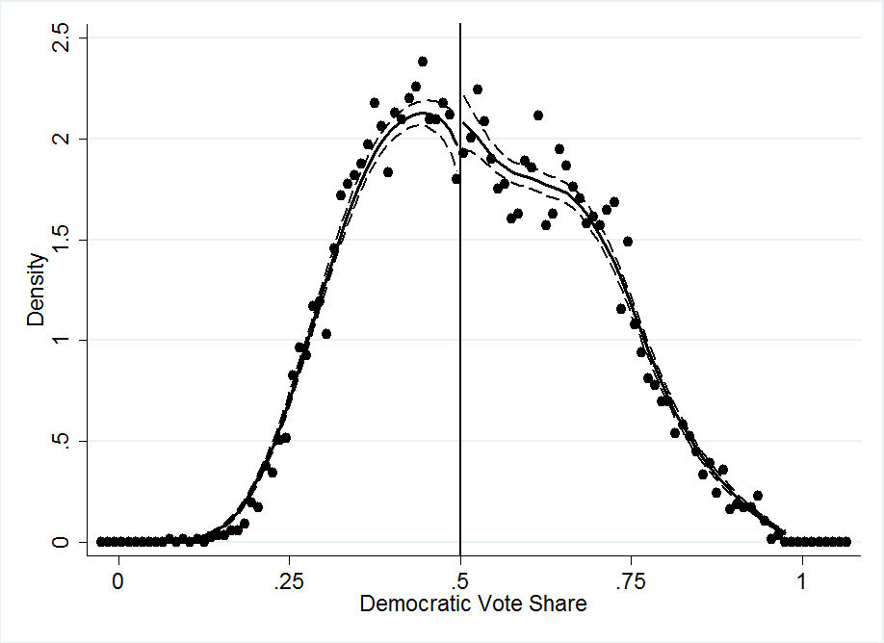
Can an RD go wrong?
Probably not. If agents have the ability to target their effort to get on either side of the discontinuity, then the discontinuity may not be a true “natural experiment”.
Is this testable? Not exactly, but somethings you can check. For example if there is a discontinuity in the histogram of the “forcing variable” at the cut-off, it indicates that agents may be targeting.

